Slide 1
Week 11 – The two parts of the 2nd Law
The 2nd Law divides the question of spontaneity into two parts:
A system part that we can get at using differential equations of state for the entropy, and thermodynamic tables of entropy
A surroundings part that deals with the entropy change of the surroundings due to heat transfer, that we can get at using thermodynamic tables of enthalpy

Slide 2
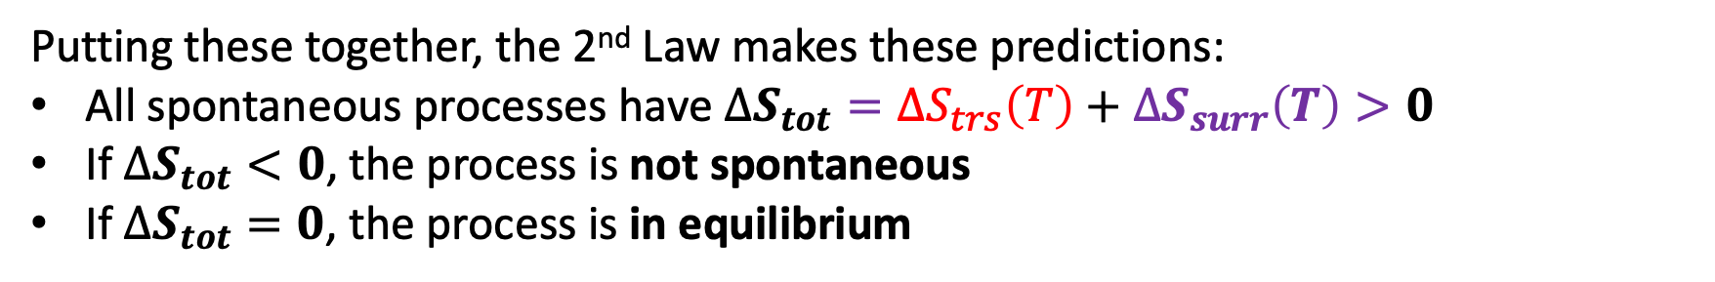
Week 11 – 2nd Law of Thermodynamics
Putting these together, the 2nd Law makes these predictions:
All spontaneous processes have $∆S_{tot}={∆S}_{trs}\left(T\right)+∆S_{surr}\left(T\right)>0$
If $∆S_{tot}<0$, the process is not spontaneous
If $∆S_{tot}=0$, the process is in equilibrium

Slide 3
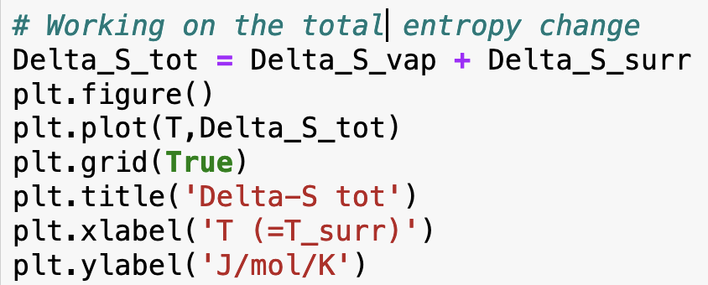
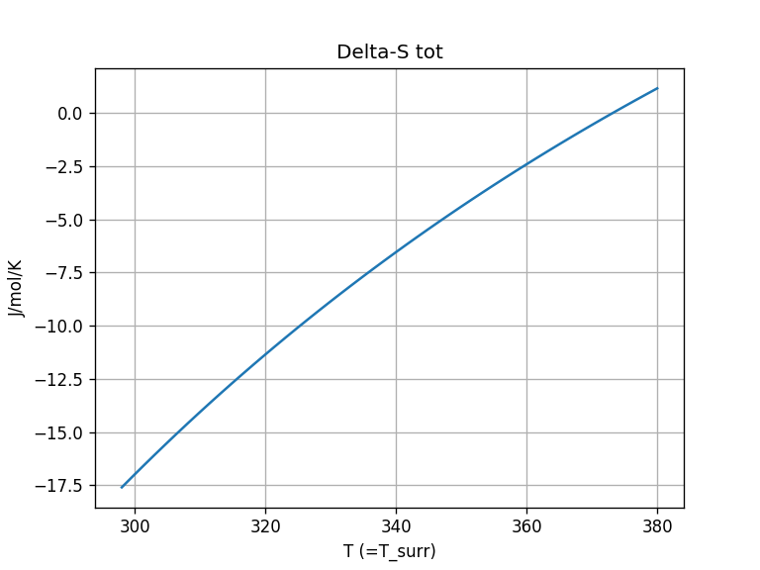
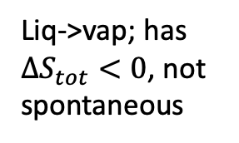
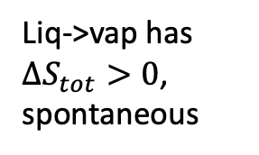
Week 11 – How you did that in Python
Liq->vap; has $∆S_{tot}<0$, not spontaneous
Liq->vap has $∆S_{tot}>0$, spontaneous

Slide 4
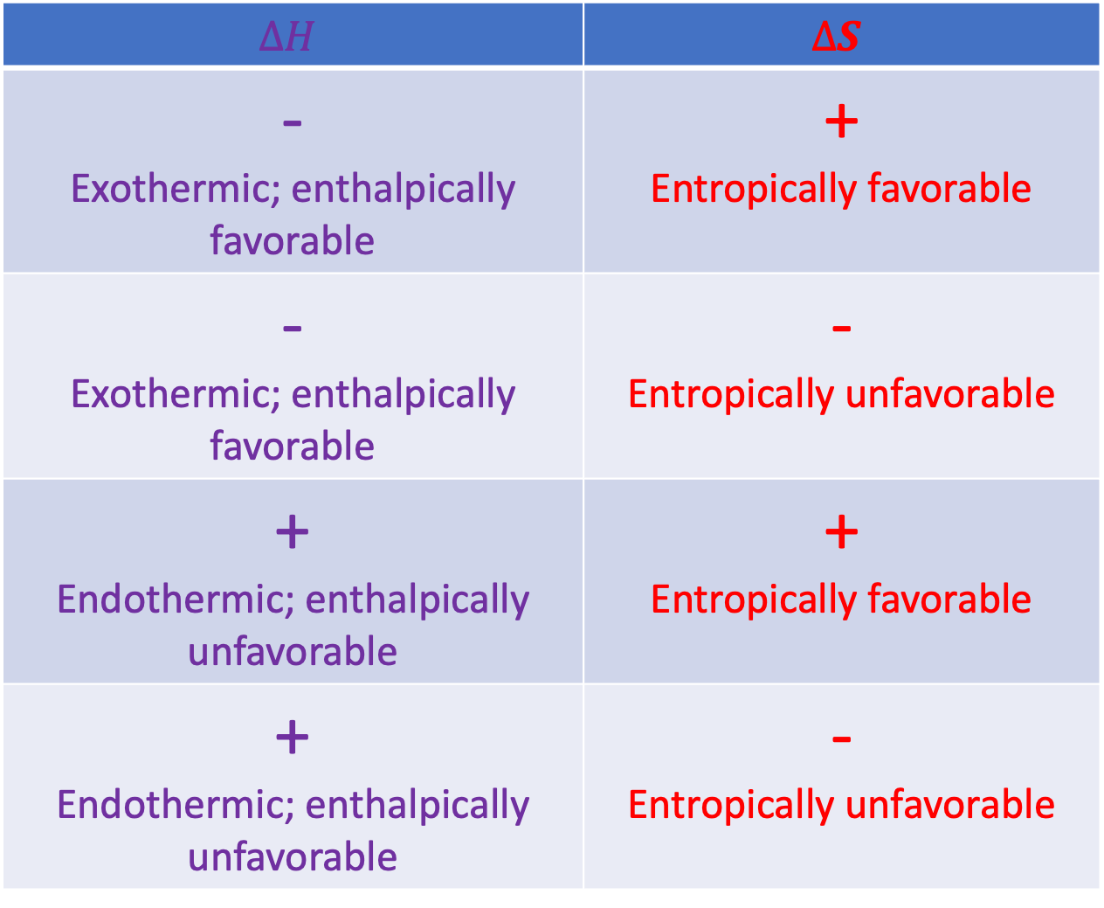
Week 11 – Systematizing the enthalpic/entropic favorability/unfavorability picture
$$∆H$$ | $$∆S$$
- Exothermic; enthalpically favorable | + Entropically favorable
- Exothermic; enthalpically favorable | - Entropically unfavorable
+ Endothermic; enthalpically unfavorable | + Entropically favorable
+ Endothermic; enthalpically unfavorable | - Entropically unfavorable

Slide 5
Week 11 – A caveat: the entropy of mixing
$∆S_{tot}=∆S+∆S_{surr}>0$ for all spontaneous processes. This is the 2nd Law
All about entropy changes of the surroundings due to heat going in/out

Slide 6
Week 11 – A caveat: the entropy of mixing
$∆S_{tot}=∆S+∆S_{surr}>0$ for all spontaneous processes. This is the 2nd Law
All about entropy changes of the surroundings due to heat going in/out
Before, we said this was all about physical changes (boiling, melting) and chemical transformations (reactions).
Now, we’re saying that it’s also about mixing.

Slide 7
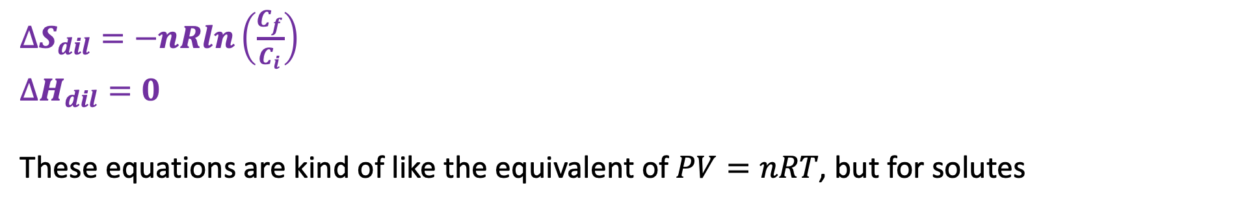
Week 11 – Entropy (and enthalpy) of dilution
$∆S_{dil}=−nRln\left(\frac{C_{f}}{C_{i}}\right)$
$∆H_{dil}=0$
These equations are kind of like the equivalent of $PV=nRT$, but for solutes

Slide 8
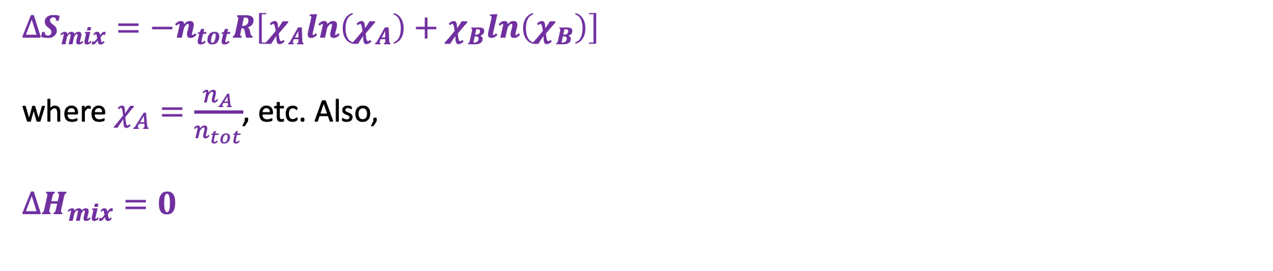
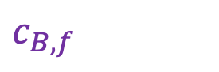
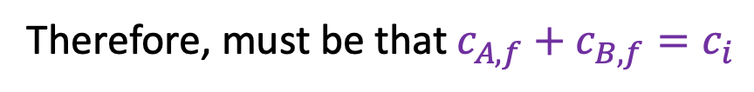
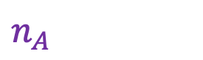
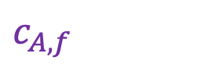
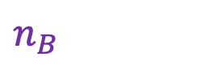
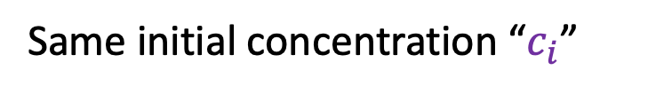
Week 11 – Entropy of mixing – the E-ICE equation
$$n_{A}$$
$$c_{B,f}$$
$$n_{B}$$
$$c_{A,f}$$
Same initial concentration “$c_{i}$”
Therefore, must be that $c_{A,f}+c_{B,f}=c_{i}$
$∆S_{mix}=−n_{tot}R\left[χ_{A}ln\left(χ_{A}\right)+χ_{B}ln\left(χ_{B}\right)\right]$
where $χ_{A}=\frac{n_{A}}{n_{tot}}$, etc. Also,
$∆H_{mix}=0$

Slide 9
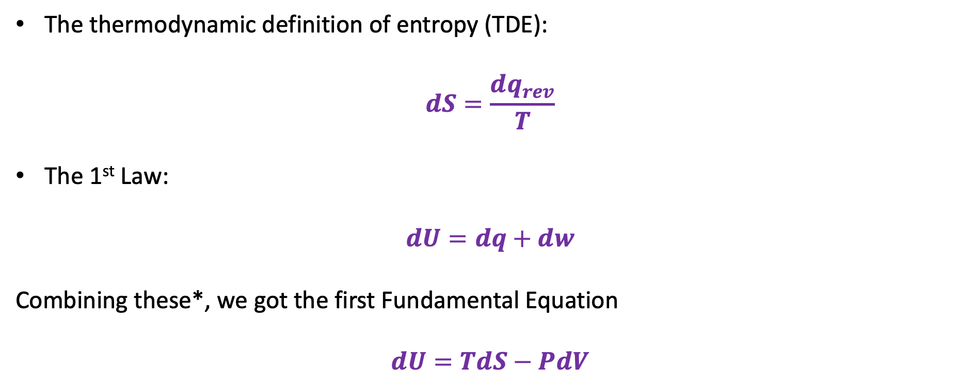
Week 11 – How the “Fundamental Equations” came about
The thermodynamic definition of entropy (TDE):
$$dS=\frac{dq_{rev}}{T}$$
The 1st Law:
$$dU=dq+dw$$
Combining these*, we got the first Fundamental Equation
$$dU=TdS−PdV$$
*Subject to conditions: reversible process with PV work only

Slide 10
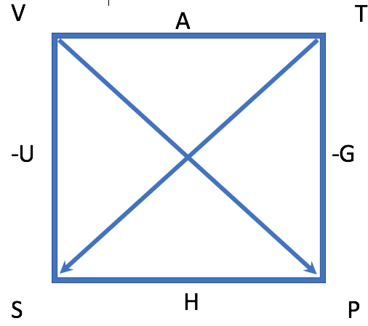
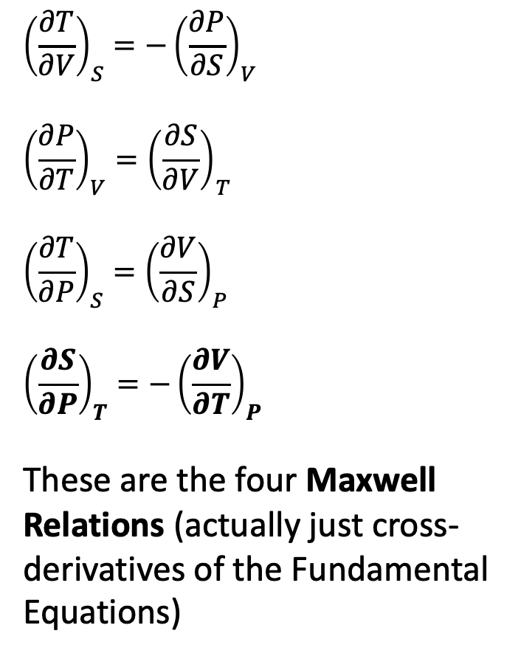
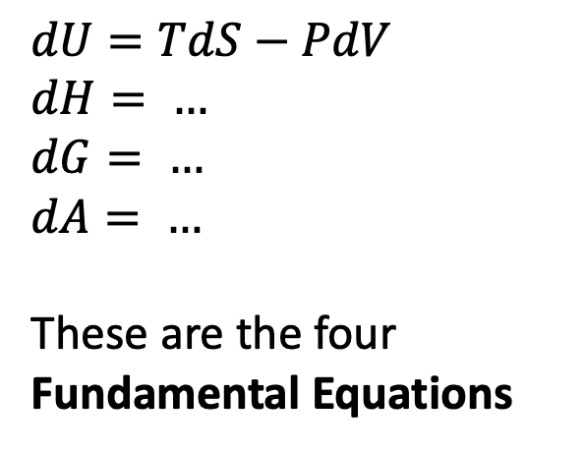
Week 11 – Using the box (actually we started this in Week 7)
$${\left(\frac{∂T}{∂V}\right)}_{S}=−{\left(\frac{∂P}{∂S}\right)}_{V}$$
$${\left(\frac{∂P}{∂T}\right)}_{V}={\left(\frac{∂S}{∂V}\right)}_{T}$$
$${\left(\frac{∂T}{∂P}\right)}_{S}={\left(\frac{∂V}{∂S}\right)}_{P}$$
$${\left(\frac{∂S}{∂P}\right)}_{T}=−{\left(\frac{∂V}{∂T}\right)}_{P}$$
These are the four Maxwell Relations (actually just cross-derivatives of the Fundamental Equations)
$dU=TdS−PdV$
$dH= …$
$dG= …$
$dA= …$
These are the four Fundamental Equations

Slide 11

Week 12 – Thermodynamics of burning a mole of coal
Only about 40% gets turned into useful electrical energy
Heat fuels an electricity-generating power plant
394 kJ/mol heat
158 kJ/mol electrical energy
Furnace

Slide 12
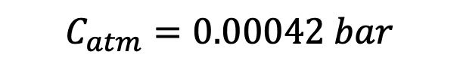
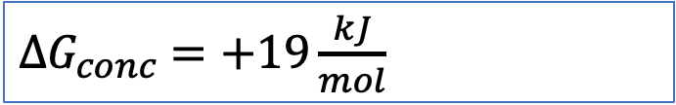
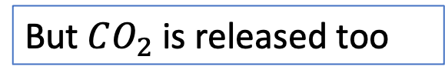
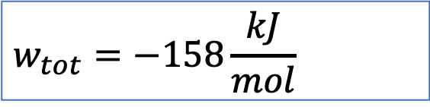
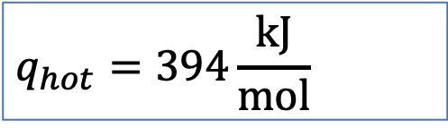
Week 12 – Thermodynamics of burning a mole of coal
$$C_{atm}=0.00042 bar$$
$$q_{hot}=394\frac{kJ}{mol}$$
But $CO_{2}$ is released too
$$w_{tot}=−158\frac{kJ}{mol}$$
$∆G_{conc}$ $=+19\frac{kJ}{mol}$
Furnace

Slide 13
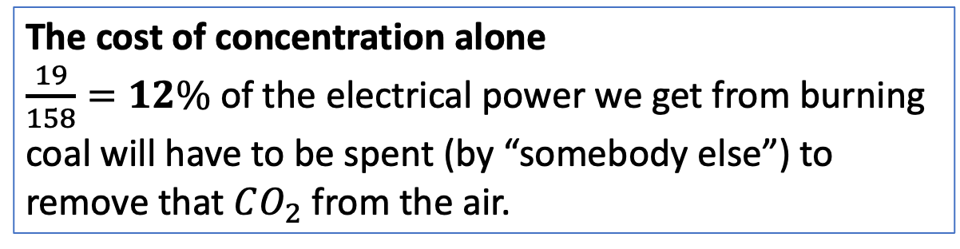
Week 12 – Thermodynamics of burning a mole of coal
$$C_{atm}=0.00042 bar$$
$$q_{hot}=394\frac{kJ}{mol}$$
But $CO_{2}$ is released too
$$w_{tot}=−158\frac{kJ}{mol}$$
The cost of concentration alone
$\frac{19}{158}=12\%$ of the electrical power we get from burning coal will have to be spent (by “somebody else”) to remove that $CO_{2}$ from the air.
$∆G_{conc}$ $=+19\frac{kJ}{mol}$
Furnace

Slide 14
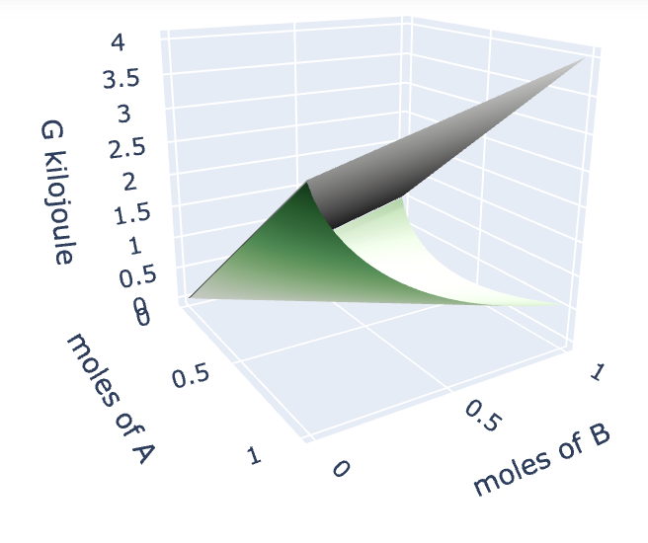
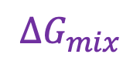


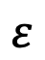
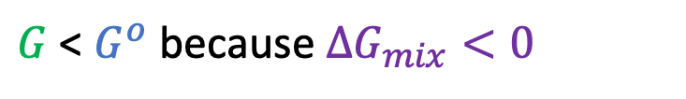
Week 12 – Gibbs energy of a reaction mixture ($A→B$)
${G=G}^{o}+∆G_{mix}$
$$G^{o}$$
$$∆G_{mix}$$
$$G$$
$$ε$$
$G$ < $G^{o}$ because $∆G_{mix}<0$

Slide 15
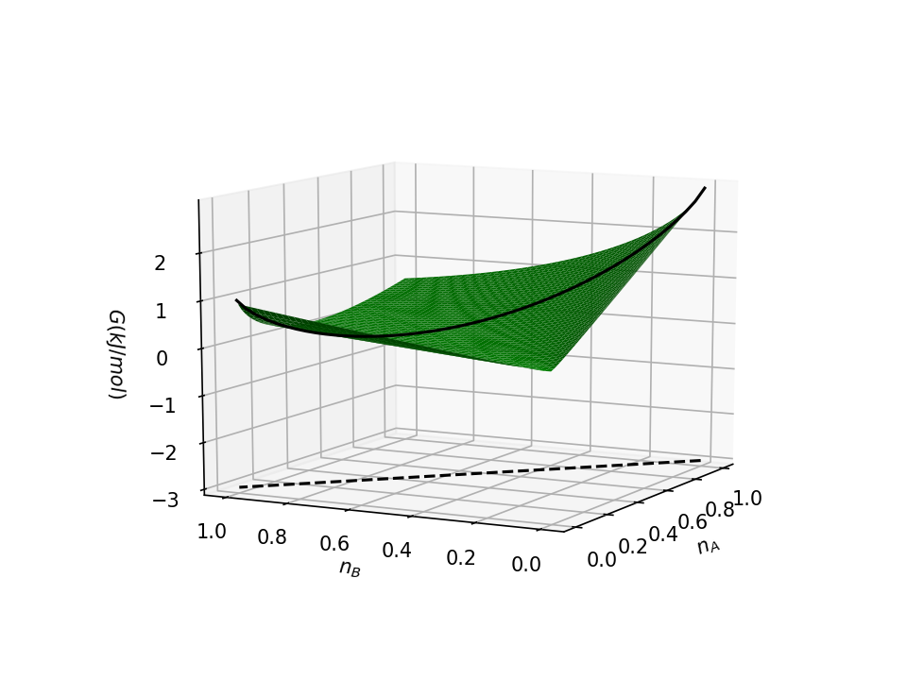
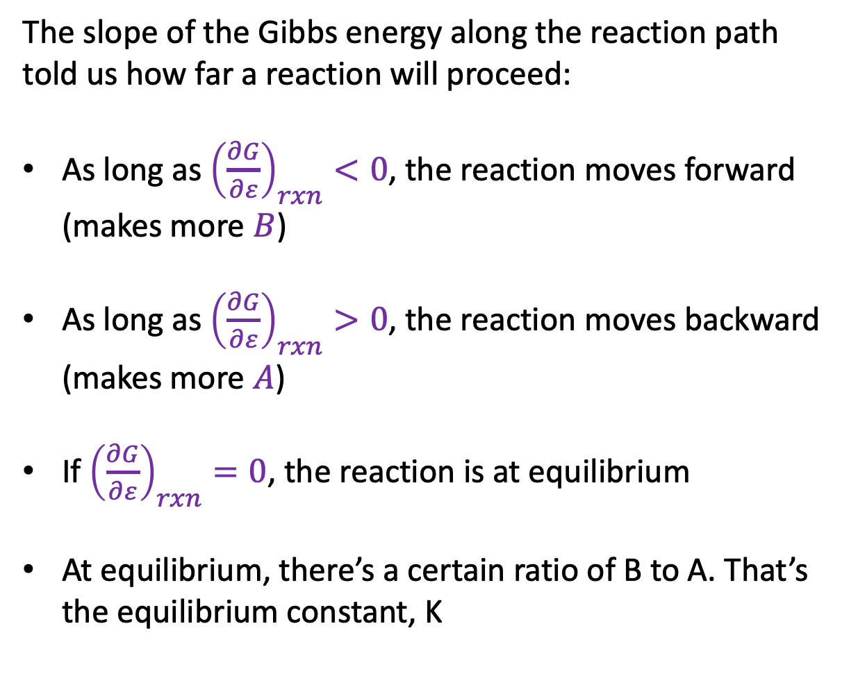
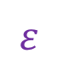
Week 12 – Gibbs energy of a reaction mixture ($A→B$)
The slope of the Gibbs energy along the reaction path told us how far a reaction will proceed:
As long as ${\left(\frac{∂G}{∂ε}\right)}_{rxn}<0$, the reaction moves forward (makes more $B$)
As long as ${\left(\frac{∂G}{∂ε}\right)}_{rxn}>0$, the reaction moves backward (makes more $A$)
If ${\left(\frac{∂G}{∂ε}\right)}_{rxn}=0$, the reaction is at equilibrium
At equilibrium, there’s a certain ratio of B to A. That’s the equilibrium constant, K
$$ε$$

Slide 16
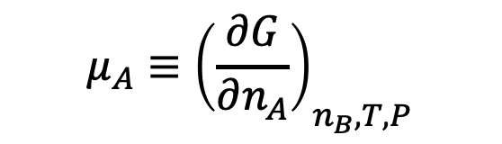
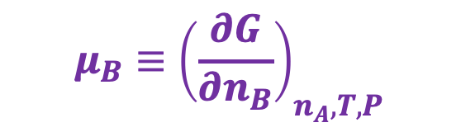
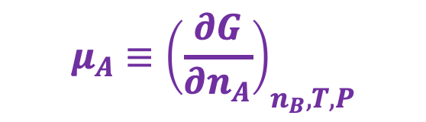
Week 12 – Chemical potentials – they’re just slopes in the $n_{A}$, $n_{B}$ state space
$$μ_{A}≡{\left(\frac{∂G}{∂n_{A}}\right)}_{n_{B}, T,P}$$
$$μ_{B}≡{\left(\frac{∂G}{∂n_{B}}\right)}_{n_{A}, T,P}$$
$$μ_{A}≡{\left(\frac{∂G}{∂n_{A}}\right)}_{n_{B}, T,P}$$

Slide 17
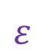
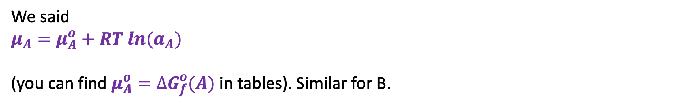
Week 12 – The chemical potential formula (CPF) and equilibria
$$ε$$
We said
$$μ_{A}=μ_{A}^{o}+RT ln{(a}_{A})$$
(you can find $μ_{A}^{o}=∆G_{f}^{o}(A)$ in tables). Similar for B.

Slide 18
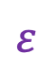
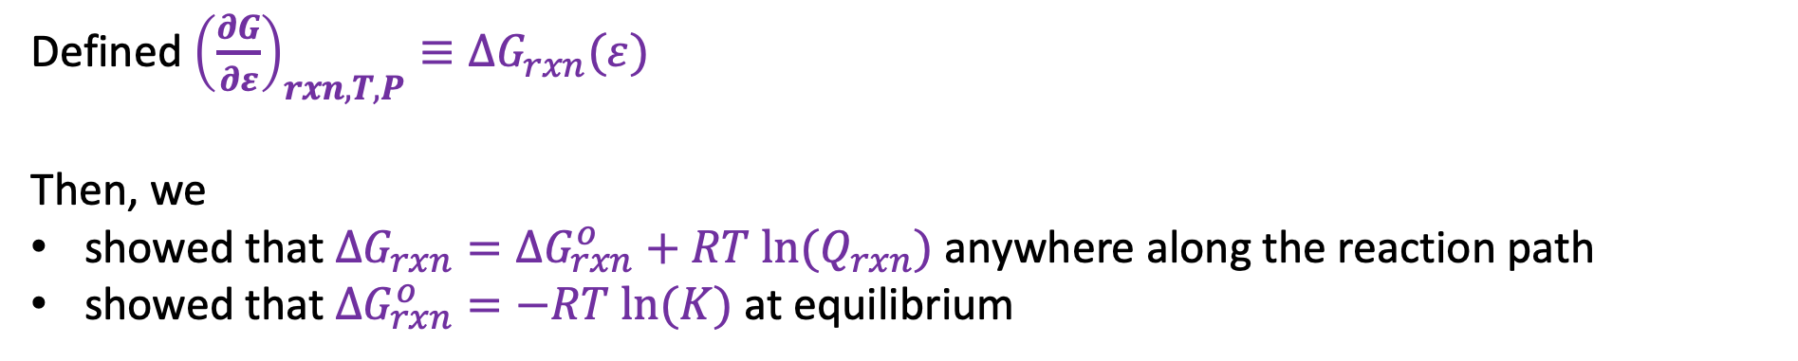
Week 12 – The chemical potential formula (CPF) and equilibria
$$ε$$
Defined ${\left(\frac{∂G}{∂ε}\right)}_{rxn,T,P}≡∆G_{rxn}(ε)$
Then, we
showed that $∆G_{rxn}=∆G_{rxn}^{o}+RT ln⁡(Q_{rxn})$ anywhere along the reaction path
showed that $∆G_{rxn}^{o}=−RT ln⁡(K)$ at equilibrium

Slide 19
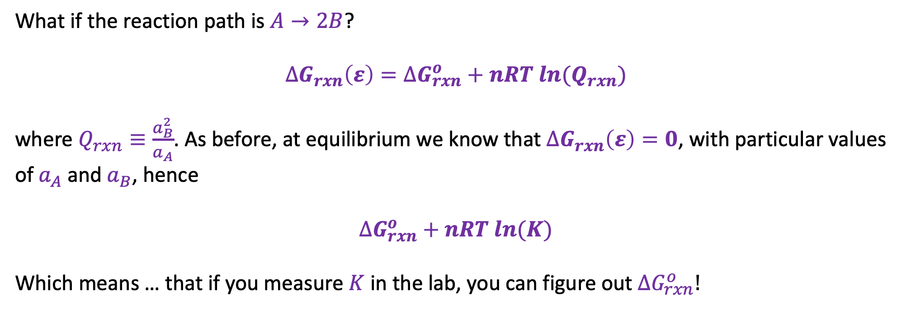
Week 12 – How $∆G_{rxn}(ε)$ depends on reaction stoichiometry
What if the reaction path is $A→2B$?
$$∆G_{rxn}\left(ε\right)=∆G_{rxn}^{o}+nRT ln{(Q}_{rxn})$$
where $Q_{rxn}≡\frac{a_{B}^{2}}{a_{A}}$. As before, at equilibrium we know that $∆G_{rxn}\left(ε\right)=0$, with particular values of $a_{A}$ and $a_{B}$, hence
$$∆G_{rxn}^{o}+nRT ln(K)$$
Which means … that if you measure $K$ in the lab, you can figure out $∆G_{rxn}^{o}!$

Slide 20
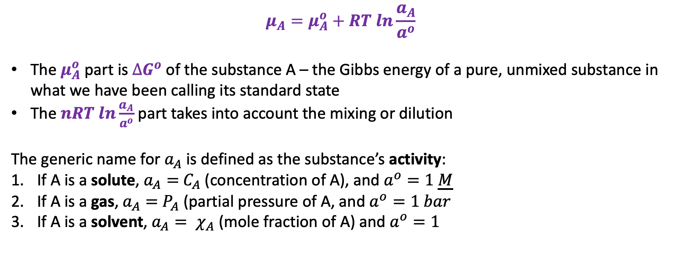
Week 12 – A generalization of the CPF
$$μ_{A}=μ_{A}^{o}+RT ln\frac{a_{A}}{a^{o}}$$
The $μ_{A}^{o}$ part is $∆G^{o}$ of the substance A – the Gibbs energy of a pure, unmixed substance in what we have been calling its standard state
The $nRT ln\frac{a_{A}}{a^{o}}$ part takes into account the mixing or dilution
The generic name for $a_{A}$ is defined as the substance’s activity:
If A is a solute, $a_{A}=$ $C_{A}$ (concentration of A), and $a^{o}=1 \underline{M}$
If A is a gas, $a_{A}=$ $P_{A}$ (partial pressure of A, and $a^{o}=1 bar$
If A is a solvent, $a_{A}= χ_{A}$ (mole fraction of A) and $a^{o}=1$

Slide 21
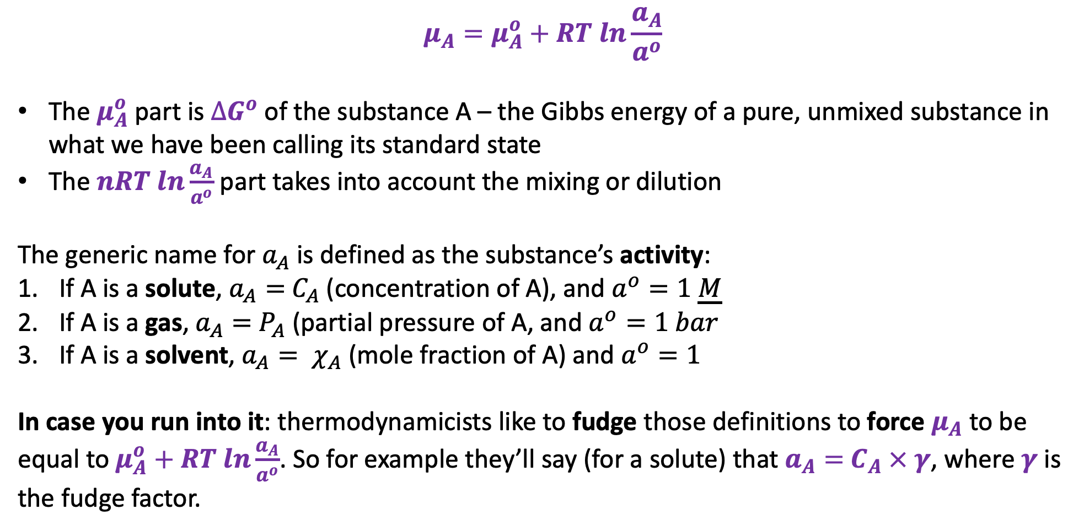
Week 12 – A generalization of the CPF
$$μ_{A}=μ_{A}^{o}+RT ln\frac{a_{A}}{a^{o}}$$
The $μ_{A}^{o}$ part is $∆G^{o}$ of the substance A – the Gibbs energy of a pure, unmixed substance in what we have been calling its standard state
The $nRT ln\frac{a_{A}}{a^{o}}$ part takes into account the mixing or dilution
The generic name for $a_{A}$ is defined as the substance’s activity:
If A is a solute, $a_{A}=$ $C_{A}$ (concentration of A), and $a^{o}=1 \underline{M}$
If A is a gas, $a_{A}=$ $P_{A}$ (partial pressure of A, and $a^{o}=1 bar$
If A is a solvent, $a_{A}= χ_{A}$ (mole fraction of A) and $a^{o}=1$
In case you run into it: thermodynamicists like to fudge those definitions to force $μ_{A}$to be equal to $μ_{A}^{o}+RT ln\frac{a_{A}}{a^{o}}$. So for example they’ll say (for a solute) that $a_{A}=$ $C_{A}$ $×$ $γ$, where $γ$ is the fudge factor.

Slide 22
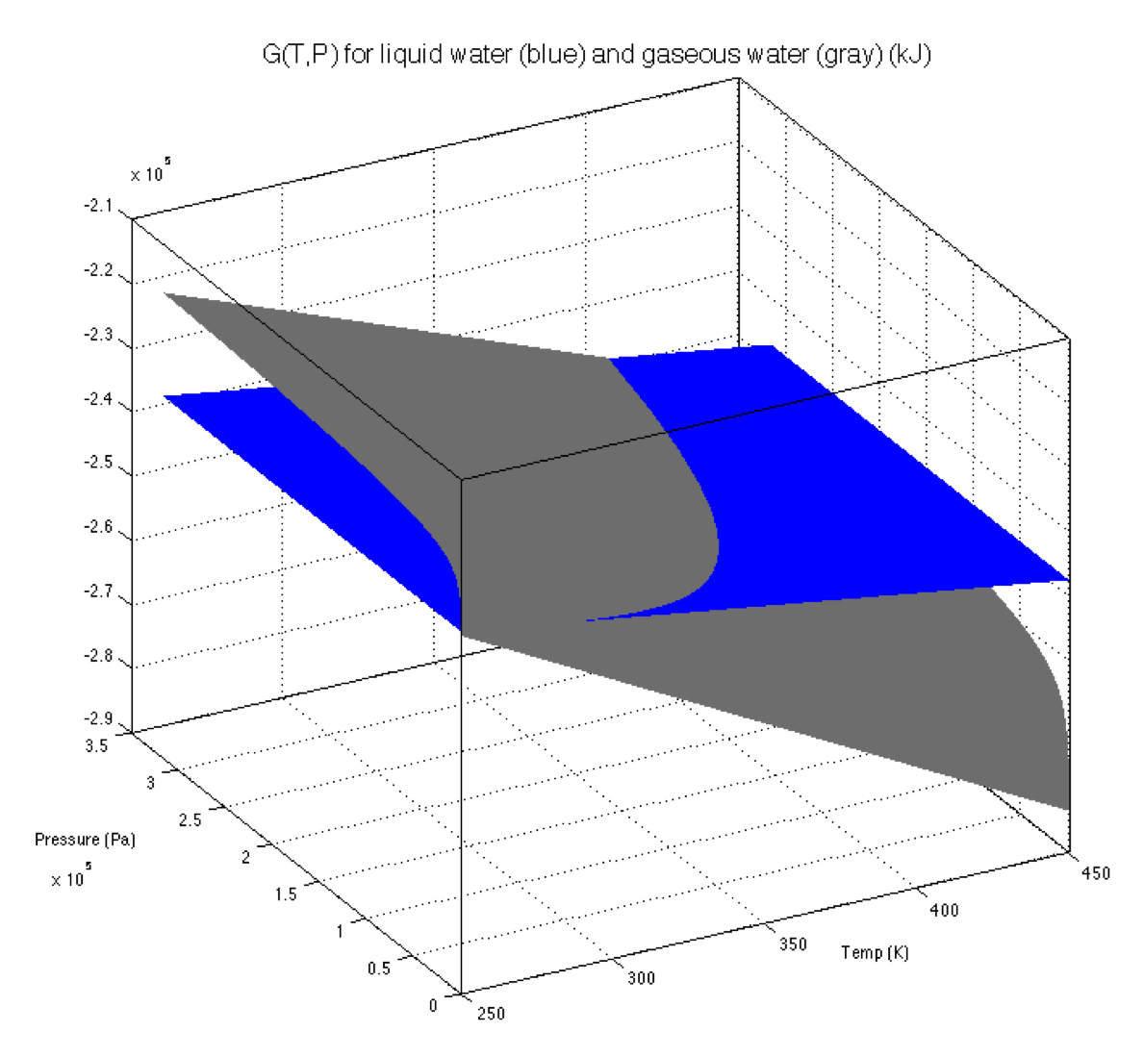
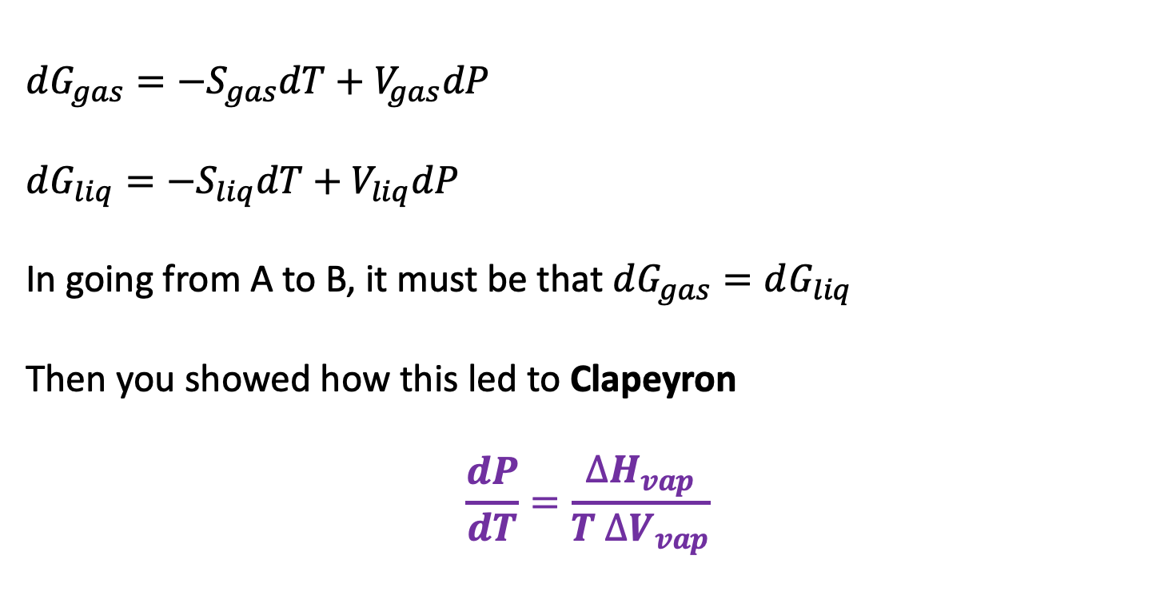
Week 12 – Derivation of the Clapeyron equation
$dG_{gas}=−S_{gas}dT+V_{gas}dP$
$dG_{liq}=−S_{liq}dT+V_{liq}dP$
In going from A to B, it must be that $dG_{gas}=dG_{liq}$
Then you showed how this led to Clapeyron
$$\frac{dP}{dT}=\frac{∆H_{vap}}{T ∆V_{vap}}$$
B
A

Slide 23
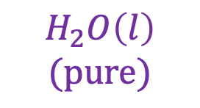
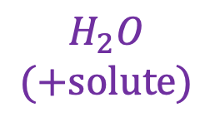
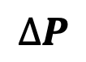
Week 12 – CPF and osmosis
Chamber X is a 1 M solution of NaCl(aq). Chamber Y is pure water.
$$∆P$$
Y
X
We could apply extra pressure $∆P$ to compensate
$$H_{2}O$$
$$(+solute)$$
$$H_{2}O\left(l\right)$$
$$(pure)$$
What direction does your intuition tell you is the direction of spontaneous change?
That means $μ_{A}(Y)>μ_{A}(X)$.

Slide 24
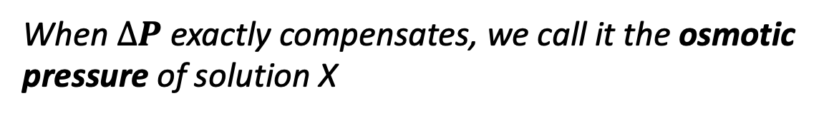
Week 12 – CPF and osmosis
Chamber X is a 1 M solution of NaCl(aq). Chamber Y is pure water.
$$∆P$$
Y
X
When $∆P$ exactly compensates, we call it the osmotic pressure of solution X
$$H_{2}O$$
$$(+solute)$$
$$H_{2}O\left(l\right)$$
$$(pure)$$
What direction does your intuition tell you is the direction of spontaneous change?
That means $μ_{A}(Y)>μ_{A}(X)$.

Slide 25
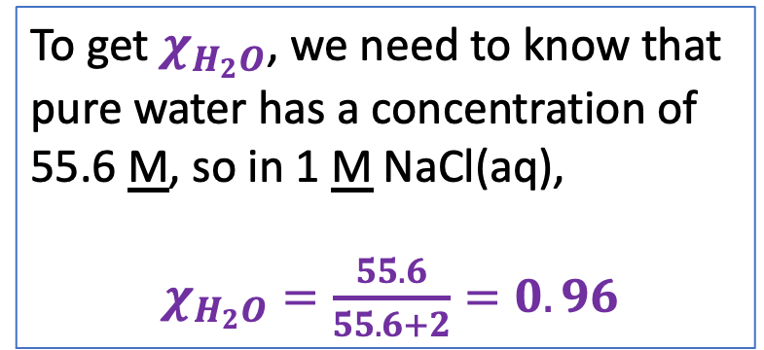
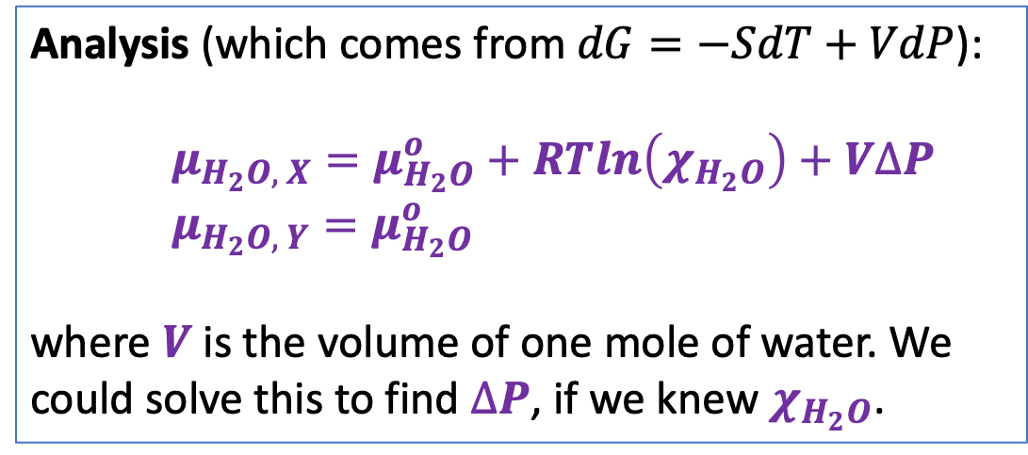
Week 12 – CPF and osmosis
Chamber X is a 1 M solution of NaCl(aq). Chamber Y is pure water.
$$∆P$$
Y
X
When $∆P$ exactly compensates, we call it the osmotic pressure of solution X
$$H_{2}O$$
$$(+solute)$$
$$H_{2}O\left(l\right)$$
$$(pure)$$
Analysis (which comes from $dG=−SdT+VdP$):
$μ_{H_{2}O, X}=μ_{H_{2}O}^{o}+RTln\left(χ_{H_{2}O}\right)+V∆P$
$μ_{H_{2}O, Y}=μ_{H_{2}O}^{o}$
where $V$ is the volume of one mole of water. We could solve this to find $∆P$, if we knew $χ_{H_{2}O}$.
To get $χ_{H_{2}O}$, we need to know that pure water has a concentration of 55.6 M, so in 1 M NaCl(aq),
$χ_{H_{2}O}=\frac{55.6}{55.6+2}=0.96$

Slide 26
Week 13 – General comments about non-PV work of concentration
State “Y”
You’d have to do work on t $w^{′}$his system to get it from X to Y ($w^{′}>0$)
The system could do work on the surroundings in going from Y to X ($w^{′}<0$)
State “X”
The equation $w^{′}=∆G_{rxn}$actually assumes reversibility, constant T and P, so we should say
$w_{rev}^{′}=∆G_{rxn}$ (constant T & P)
In real life, inefficiencies in how X is converted to Y mean that $∆G_{rxn}$defines a lower thermodynamic limit on the necessary work: |$w_{actual}^{′} |≥|∆G_{rxn}|$.
In real life, inefficiencies in how the relaxation of Y to X is coupled to other processes (say, building proteins) mean that $∆G_{rxn}$ defines an upper thermodynamic limit on the work available: | $w_{actual}^{′} |≤|∆G_{rxn}|$.

Slide 27
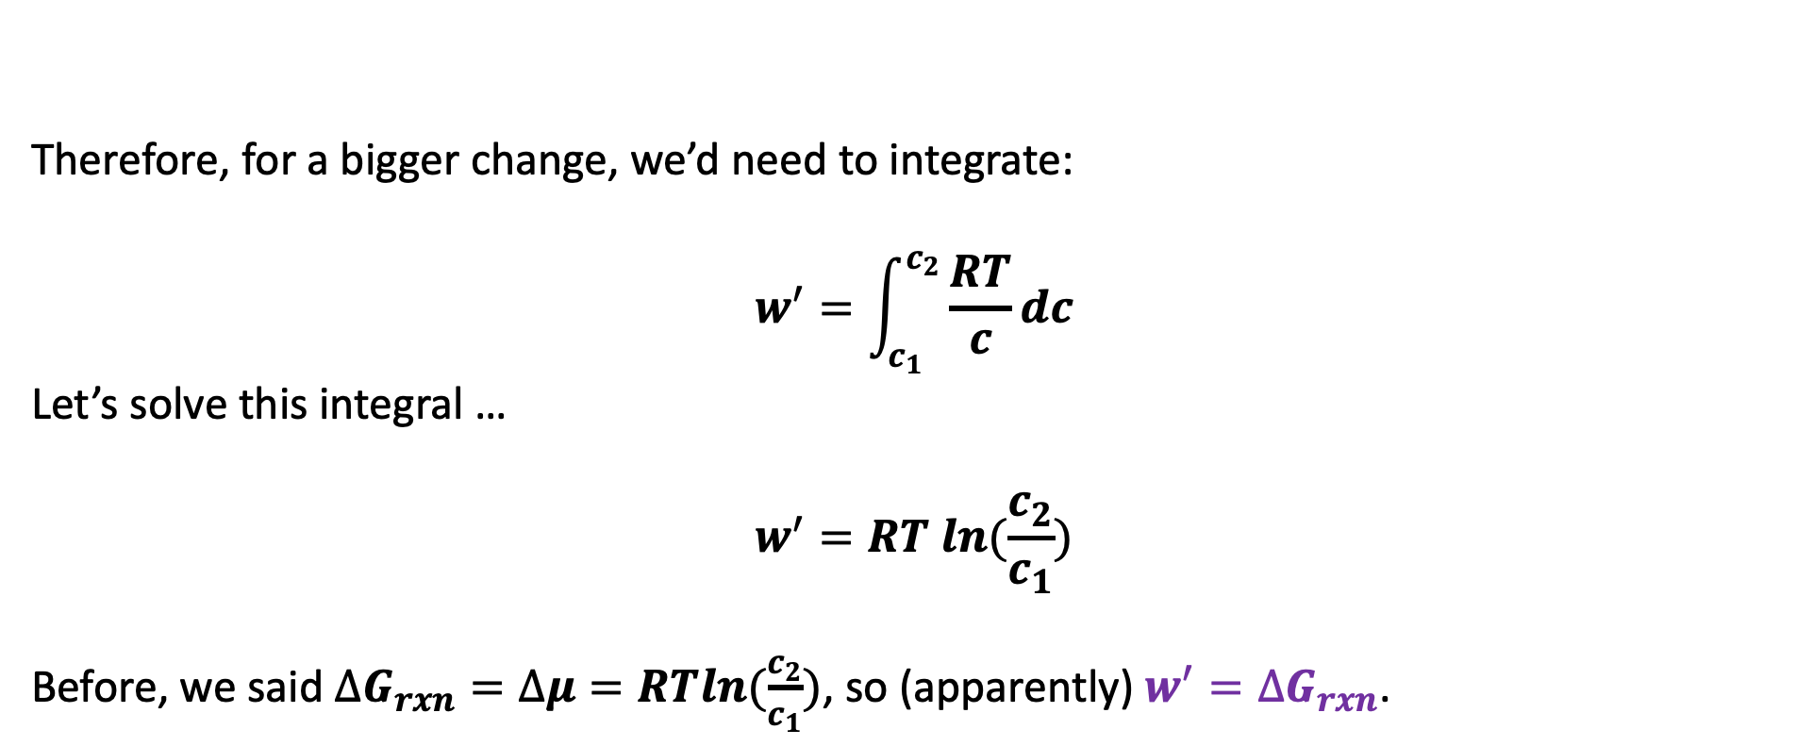
Week 13 – Calculating the non-PV work of concentration
$$c_{1}$$
$$c_{2}$$
Therefore, for a bigger change, we’d need to integrate:
$$w^{′}=\int_{c_{1}}^{c_{2}}{\frac{RT}{c}dc}$$
Let’s solve this integral …
$$w^{′}=RT ln(\frac{c_{2}}{c_{1}})$$
Before, we said $∆G_{rxn}=∆μ=RTln(\frac{c_{2}}{c_{1}})$, so (apparently) $w^{′}=∆G_{rxn}$.

Slide 28

Week 13 – Calculating the non-PV work of concentration
$$c_{1}$$
$$c_{2}$$
Therefore, for a bigger change, we’d need to integrate:
$$w^{′}=\int_{c_{1}}^{c_{2}}{\frac{RT}{c}dc}$$
Let’s solve this integral …
$$w^{′}=RT ln(\frac{c_{2}}{c_{1}})$$
Before, we said $∆G_{rxn}=∆μ=RTln(\frac{c_{2}}{c_{1}})$, so (apparently) $w^{′}=∆G_{rxn}$. This would work even if the “path” led across (say) a mitochondrial cell wall.

Slide 29


Week 13 – Gibbs-Helmholtz
We can look up $∆G_{rxn}^{o}$ at standard temperature ($T=298 K$), but what is it at a other temperatures (say $T=400 K$)?
Gibbs-Helmholtz allows us to make a prediction subject only to the assumption that $∆H_{rxn}^{o}$ is constant over the desired temperature range (which is often a pretty good assumption).
$$T_{1}$$
$$T_{2}$$

Slide 30

Week 14 – A bulk property you might not have known about: Thermophoresis
Etymology: thermo (“heat”) + phoresis (“to carry”)

Slide 31







Week 14 – How ${∆U}_{sol}$ will help us predict whether thermophoresis will be thermophobic or thermophilic
$${∆U}_{sol}$$
$${∆U}_{sol}$$
$${∆U}_{sol}$$
A
C
B
D

Slide 32







Week 14 – Roadmap from vibrations -> partition functions -> ${∆U}_{sol}$
Talk about how vibrations behave at the quantum level (energy quantization)
Introduce $Z′$, the unscaled partition function
See how $Z′$ leads to ${∆U}_{sol}$ (and therefore predict thermophoresis)
$Z′$
$$T$$
$${∆U}_{sol}$$
$$x$$

Slide 33


Week 14 – Frequency of the $R−NH_{2}$ (scissor) vibration in the low-temperature limit
$${\overline{ν}}_{LT}$$

Slide 34








Week 14 – If T is too low …
$\frac{3}{2}RT≪E_{gap}$ so no vibrational excitation
$$E_{gap}$$
A little bump
Solute in vibrational ground state
Cold incoming solvent
Compressed
Equilibrium
Stretched-out

Slide 35
Week 14 – At high enough T …
$$E_{gap}$$
Bam!
Solute in vibrational ground state
Incoming solvent molecule
Compressed
Equilibrium
Stretched-out

Slide 36


Week 14 – Introducing $Z′$ (which we’re calling the unscaled part of the partition function)
$Z′$ is the number of vibrational states that are accessible to a molecule.
The temperature is high enough now that $n=1$ and $n=2$ are thermally accessible -- so $Z′$ is getting even bigger!
$$E_{gap}$$
Summary for $Z′$:
At really low temperature, collisions with surrounding molecules don’t have enough energy to populate excited states, so $Z′≈1$.
At higher temperature, more and more excited vibrational states are accessible, so $Z^{′}>1$.

Slide 37










Week 14 – Getting $Z′$ from $\overline{ν}$ and $T$
Start with $\overline{ν}$, the frequency of vibration you got from Spartan
$$E_{gap}=N_{A}ℏ2πc\overline{ν}$$
$$E_{gap}$$
$$∆E_{n}={nE}_{gap}$$
$$E_{gap}$$
$$E_{gap}$$
$Z_{n}^{′}=exp⁡(−∆E_{n}/RT)$
$$E_{gap}$$
$$E_{gap}$$
$Z′=\sum_{n}{Z_{n}^{′}}$

Slide 38






Week 14 – From $Z_{n}′$ $→ Z^{′}$
$Z_{n}′$
$Z^{′}$
Notice that $Z^{′}$is a function of distance ($x$) only, since we’ve summed over quantum numbers ($n$)

Slide 39






Week 14 – One last blackboard derivation … What if we say $Z^{′}=1$?
where $E_{o}=\frac{E_{gap}}{2}$
$$E_{gap}(x)$$
Derive an expression for ${∆U}_{sol}$ as a function of $E_{gap}\left(x\right)$ and $\frac{{dE}_{gap}}{dx}$ assuming:
$E_{o}=\frac{E_{gap}}{2}$
$Z^{′}=1$
$T\left(x\right)=T_{cold}+∆T$
$∆T=\left(T_{hot}−T_{cold}\right)$

Slide 40





Week 14 – Results when we say $Z^{′}=1$?
When the collisional energy ($\frac{3}{2}RT$) is much smaller than the gap between vibrational energy levels ($E_{gap}$), we have very little population of excited vibrational states. If we ignore those excited-state populations altogether, then $Z≈e^{−\frac{E_{o}}{RT}}$, where $E_{o}=\frac{E_{gap}}{2}$, and
$U_{sol}^{approx}\left(x\right)=RT^{2}\frac{d\ln\left(Z\right)}{dx}\frac{dx}{dT}≈\frac{1}{2}\left(E_{gap}\left(x\right)−L\frac{T}{∆T}\frac{dE_{gap}}{dx}\right)$
The result, shown on the left below, is basically identical to what we get when we don’t ignore the excited-state populations. On the right is the difference between Eq. 1 and the result when excited-state populations are not ignored.
$$U_{sol}^{approx}−U_{sol}$$
$$U_{sol}^{approx}$$

Slide 41





Week 15 – Fractional distillation
cold
vapor composition
hot
liquid composition

